Slide 1
S&P 500 Prediction and Trading Strategy
Ahmed Bilal, Shu Bin, Ray Song

Slide 2
In the Last Episode
Attempted classic ARIMA models
Exhibits heteroskedasticity
GARCH model good fit

Slide 3
New Strategies
Rolling Window ARIMA+GARCH model
Bollinger Bands

Slide 4
New Strategy
ARIMA+GARCH model for each datapoint
Provides more accurate prediction and better trading strategy

Slide 5
Data treatment
S&P 500 Closing Price
Take logarithm
Take first difference

Slide 6
Rolling Window Strategy
An arbitrary parameter: W
Notes:
What this does it that, for each index to predict, we fit an ARIMA GARCH model over the previous w number of index values. After each index is predicted, we use the new predicted index to fit another ARIMA GARCH model to predict the next index.

Slide 7
For each data point in rolling window, w:
Models.list = []
For (p in 0:5) for (q in 0:5){
Current.model = fit ARIMA(p, 0, q)
Models.list += Current.model
}
For model in Models.list{
If model has lowest AIC{
Final.model = model
}
}
Return final.model
Notes:
After applying an ARIMA+GARCH model at different time periods in the SP 500, we realized that the best ARIMA+GARCH specification varied greatly for each time segment. As a result, we decided we would need to test 24 ARIMA+GARCH models for each data point prediction. So the run-time is high for each model fit.
The best fit ARIMA models were picked on their AIC scores as this was the best criteria, from our testing during our midterm project.
We ignore ARIMA(0,0,0)

Slide 8
Fitting a GARCH(1,1) model
After applying the ARIMA model, we use the variance of the error terms from the model fit
From our midterm project, we determined the best GARCH fit was (1,1)for error term variance
Use numerical optimization to find the minimum value of the quasi-likelihood equation
GARCH(1,1) convergence problem
Notes:
returns to financial instruments (such as stocks or mutual funds) exhibit behavior known as volatility clustering. Some periods a financial instrument is relatively docile; there are not dramatic market movements. In others an instrument’s price can fluctuate greatly, and these periods are not one-off single-day movements but can last for a period of time. GARCH models were developed to model volatility clustering.
It is believed by some that even if a stock’s daily movement is essentially unforecastable (a stock is equally likely to over- or under-perform on any given day), the volatility is forecastable.
one of the most important tasks for these processes is estimating their parameters; for the process, these are , , and . A basic approach is to find the quasi-maximum likelihood estimation (QMLE) estimates
In QMLE, we work with the conditional distribution of error term
To minimize the quasi-likelihood equation, there is no closed form solution for the parameters that minimize this quantity. This means that numerical optimization techniques must be applied to find the parameters
We have chosen to use hybrid, which tries different solvers in order to increase the likelihood of convergence
If the GARCH model does not converge then we simply set the day to produce a "long" prediction, which is clearly a guess. However, if the model does converge then we output the date and tomorrow's prediction direction (+1 or -1) as a string at which point the loop is closed off.
parameters estimation in a/symmetric GARCH(1,1) model assuming normal distribution of returns is not that simple, i.e. it is difficult to solve it analytically. Maximum of the likelihood function can be founded by iteration procedure until no further increase can be found. Because the solutions of the numerical optimization are very sensitive to the initial values, GARCH(1,1) model starting parameters are defined. The number of iterations can be reduced using starting values close to the global maximum.
To investigate if local maximum is the global optimum we should use different starting values and observe whether convergence occurs at the same parameter values.
convergence problem may arise, because the more parameters in the model are entered the "flatter" the loglikelihood function becomes, and therefore the more difficult it is to maximize.

Slide 9
GARCH (1,1) pseudo code
> chose_specification = ugarchspec(
> var_model=list(garchOrder=c(1,1))
> mean.model=list(arimaOrder=c(ARIMA model chosen from before))
> fit = tryCatch(
> ugarchfit(
> spec, sp500Returns, solver = 'numericaL_solution_hybrid'
> If does not converge: error=function(e) e, chose strategy ‘long’; otherwise save tomorrow’s prediction: +1/-1

Slide 10
Buying and Selling Strategy
Calculate the ARIMA+GARCH returns by multiplying the forecast sign with the SP500 returns
Plot equity curves with ARIMA+GARCH strategy versus the most common passive strategy: “Buy and Hold” strategy to compare with how the market moves
Notes:
Buy and hold is a passive investment strategy in which an investor buys stocks (or other types of securities such as ETFs) and holds them for a long period regardless of fluctuations in the market. An investor who uses a buy-and-hold strategy actively selects investments but has no concern for short-term price movements and technical indicators.

Slide 11
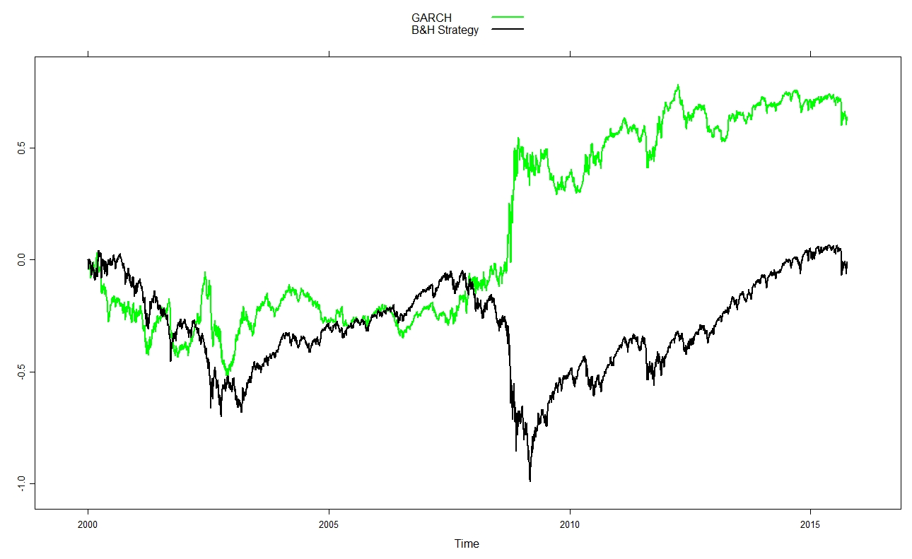
Rolling window = 500
Notes:
Here, the yellow line is our trading strategy, while the black line is the buy and hold strategy.
As you can see, before 2009, the two strategies’ returns are very comparable. With each one surpassing the other one briefly.
However, after 2009, the GARCH strategy significantly surpasses the buy and hold strategy.
This could be due to the stock market crash in 2009. During that time, it’s likely that each movement in the index are highly correlated, as opposed to the more stochastic trends of the other years.
The the returns levels again after the stock market steadies back into a stochasitc trend.

Slide 12
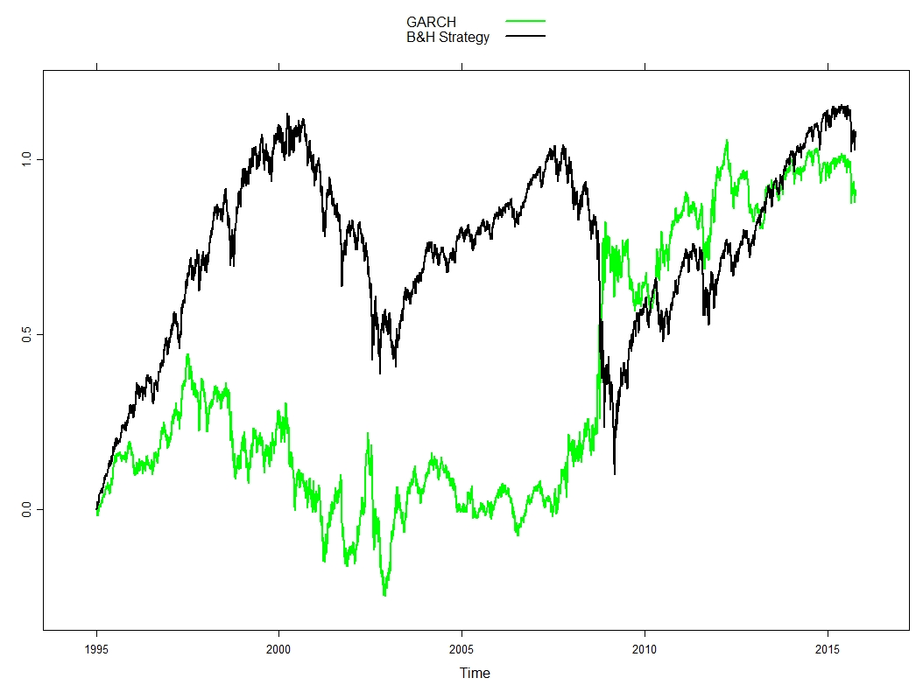
Rolling window = 50
Notes:
The previous prediction with rolling window at 500 had a really large runtime.
As a little sensitivity analysis, we changed the rolling window parameter to 50 and see how the prediction would carry out.
As you can see here, our trading strategy is considerably worse with the rolling window set to 50.

Slide 13
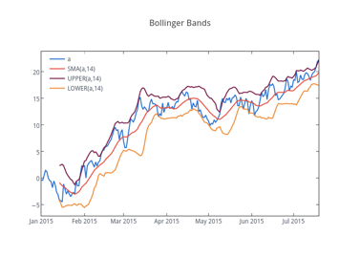
Bollinger Bands
A Bollinger Band is a technical analysis tool defined by a set of lines plotted two standard deviations (positively and negatively) away from a simple moving average (SMA) of the security price.

Slide 14
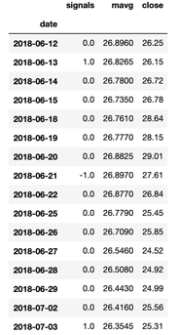
Example
Long when close price enters lower-band
Short when open price enters upper-band

Slide 15
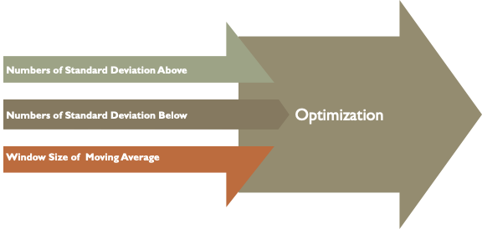
Parameters

Slide 16
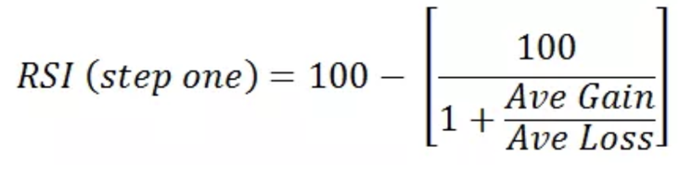
Relative Strength Index

Slide 17
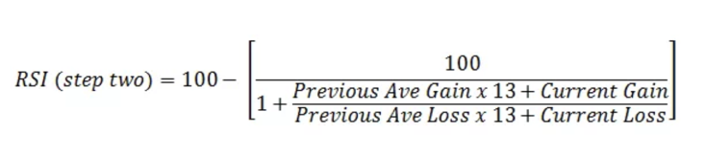
Relative Strength Index

Slide 18
Divergence
Indicators occurs when relative strength indicator moves in the opposite direction against the moving average

Slide 19
Linear Regression
Divergence indicators consist of two slopes, RSI and SMA
Instead of arbitrarily connecting the data points at the beginning and at the end of the window, a linear regression is used to obtain the slopes

Slide 20
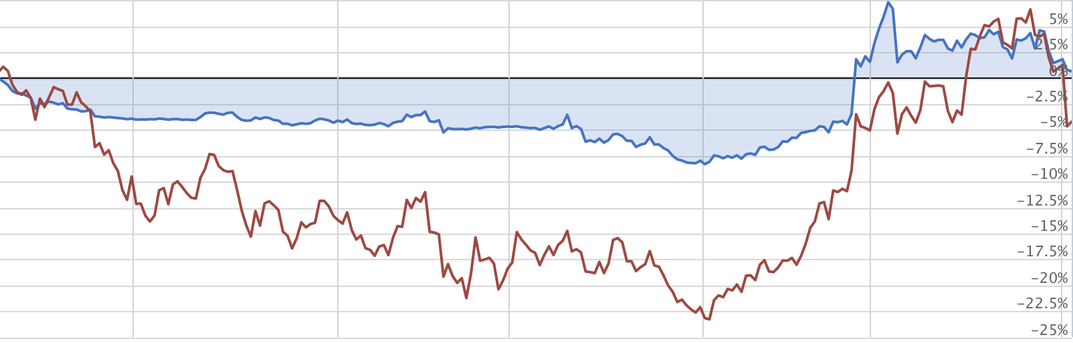
Results

Slide 21
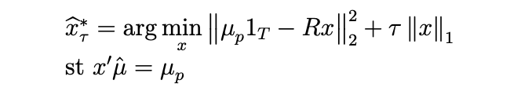
Lasso Regression
L1 Regularization
Selection Model

Slide 22
Lasso - Meta Strategy
Inputs: estimates and returns
Outputs: Weights of different strategies
Compare Equal Weighted Strategies to Weighted According to Estimates

